Slide 1
Independence Movement
Review

Slide 2
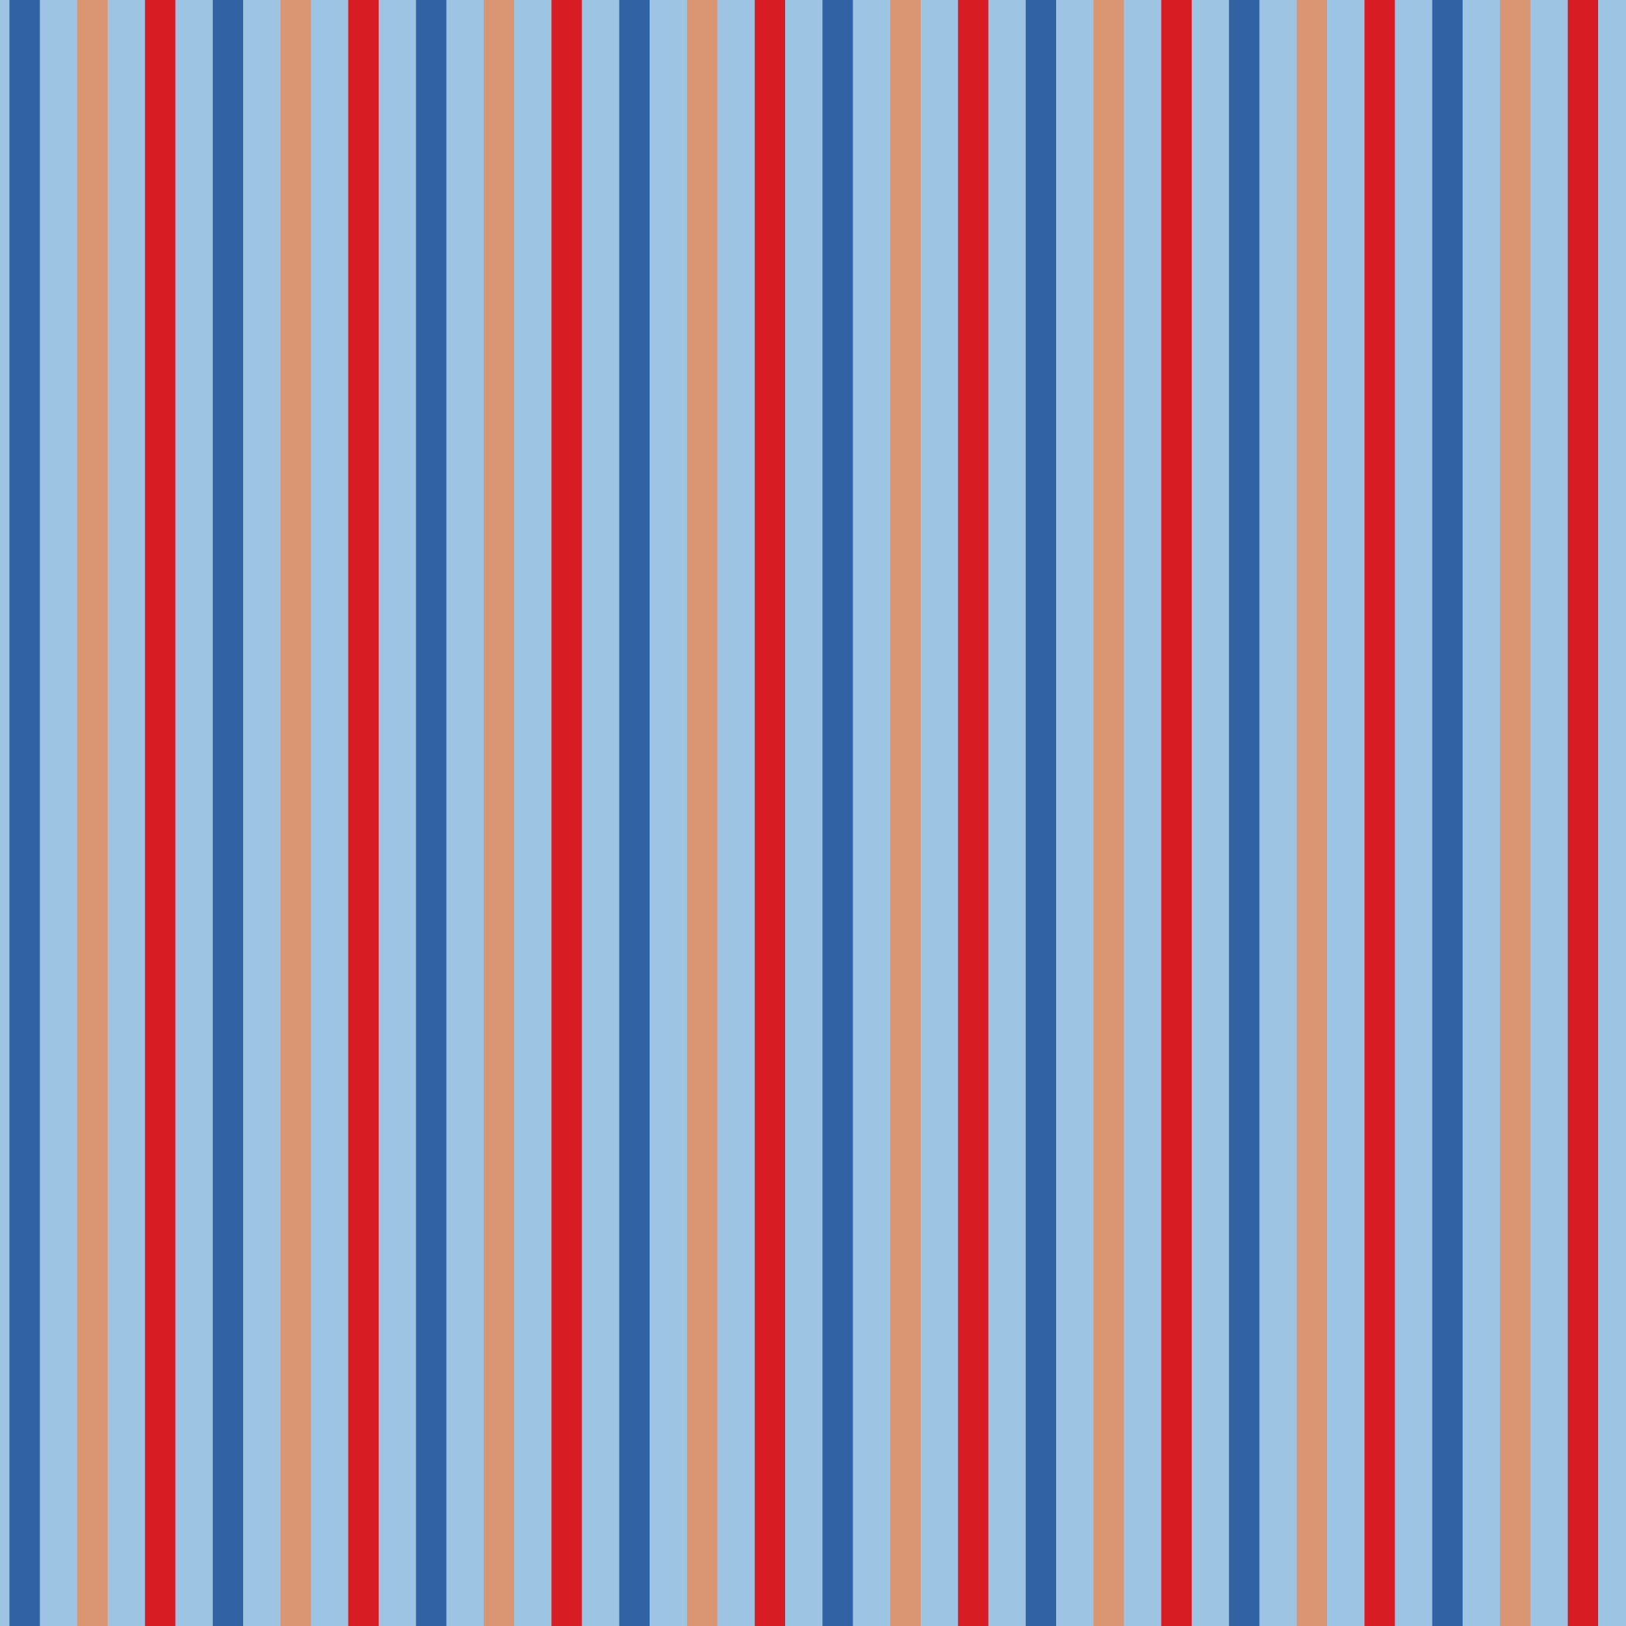
Who Am I?
The country of Bolivia was named in my honor.
© Brain Wrinkles

Slide 3
I Am…
Simon Bolivar
© Brain Wrinkles

Slide 4
Who Am I?
I am known as the Father of Mexican Independence.
© Brain Wrinkles

Slide 5
I Am…
Miguel Hidalgo
© Brain Wrinkles

Slide 6
Who Am I?
I was able to end Spanish rule in much of South America.
© Brain Wrinkles

Slide 7
I Am…
Simon Bolivar
© Brain Wrinkles

Slide 8
Who Am I?
I was imprisoned & died in France.
© Brain Wrinkles

Slide 9
I Am…
Toussaint L’Ouverture
© Brain Wrinkles

Slide 10
Who Am I?
I am a wealthy Venezuelan who was educated in Europe.
© Brain Wrinkles

Slide 11
I Am…
Simon Bolivar
© Brain Wrinkles

Slide 12
Who Am I?
I was a Catholic priest in Mexico.
© Brain Wrinkles

Slide 13
I Am…
Miguel Hidalgo
© Brain Wrinkles

Slide 14
Who Am I?
I helped citizens gain independence in Haiti.
© Brain Wrinkles

Slide 15
I Am…
Toussaint L’Ouverture
© Brain Wrinkles

Slide 16
Who Am I?
I fought for freedom from European rule.
© Brain Wrinkles

Slide 17
I Am…
All 3
© Brain Wrinkles

Slide 18
Who Am I?
Colombia, Ecuador, Panama, and Peru won their independence through my efforts.
© Brain Wrinkles

Slide 19
I Am…
Simon Bolivar
© Brain Wrinkles

Slide 20
Who Am I?
I am a former slave who was self-educated.
© Brain Wrinkles

Slide 21
I Am…
Toussaint L’Ouverture
© Brain Wrinkles

Slide 22
Who Am I?
I am the only one of the 3 who lived to see my country gain independence.
© Brain Wrinkles

Slide 23
I Am…
Simon Bolivar
© Brain Wrinkles

Slide 24
Who Am I?
I believe in freedom and equality for all.
© Brain Wrinkles

Slide 25
I Am…
All 3
© Brain Wrinkles

Slide 26
Who Am I?
My nickname is “The Liberator”.
© Brain Wrinkles

Slide 27
I Am…
Simon Bolivar
© Brain Wrinkles

