Slide 1
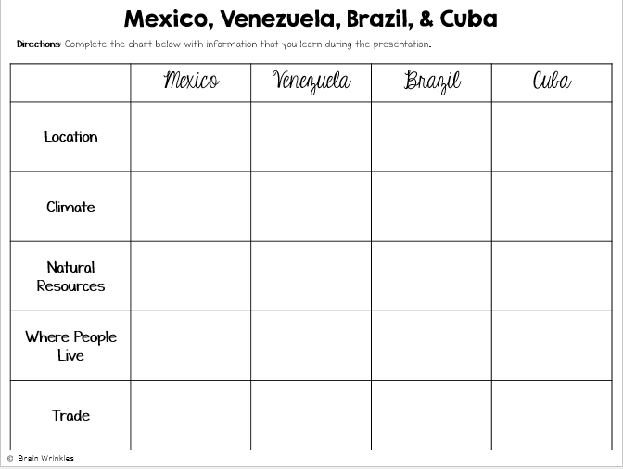
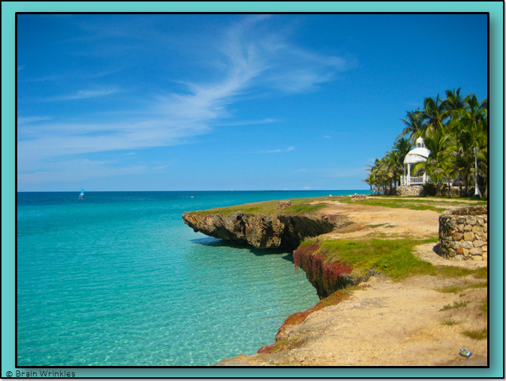
Location, Climate, & Natural Resources of
Mexico, Brazil, Venezuela, & Cuba
Presentation, Graphic Organizers, & Activities

Slide 2
STANDARDS:
SS6G3 The student will explain the impact of location, climate, distribution of natural resources, and population distribution on Latin America and the Caribbean.
a. Compare how the location, climate, and natural resources of Mexico and Venezuela affect where people live and how they trade.
b. Compare how the location, climate, and natural resources of Brazil and Cuba affect where people live and how they trade.
© Brain Wrinkles

Slide 3
Location, Climate, & Natural Resources of
Mexico,
Venezuela,
Cuba, & Brazil
Where People Live
& How They Trade
© Brain Wrinkles

Slide 4
Mexico
© Brain Wrinkles

Slide 5
Location
It’s south of the US, east of the Pacific Ocean, and west of the Gulf of Mexico & Caribbean Sea.
It’s great that it’s located between major bodies of water because:
Great opportunities for trading
Can easily ship goods around the world
Another advantage: close to US, so trade between two countries is convenient.
© Brain Wrinkles

Slide 6
© Brain Wrinkles

Slide 7
Climate
In Mexico, the climate varies according to location:
The northern part is mostly desert (hot).
The beaches have a tropical climate.
Mountains and plains have a more mild climate.
© Brain Wrinkles

Slide 8
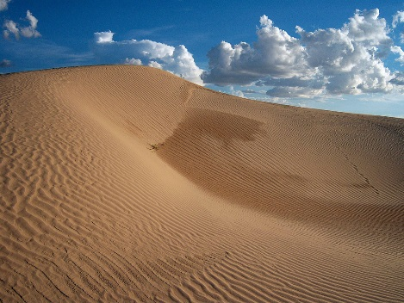
Chihuahua (Mexican state)
© Brain Wrinkles

Slide 9
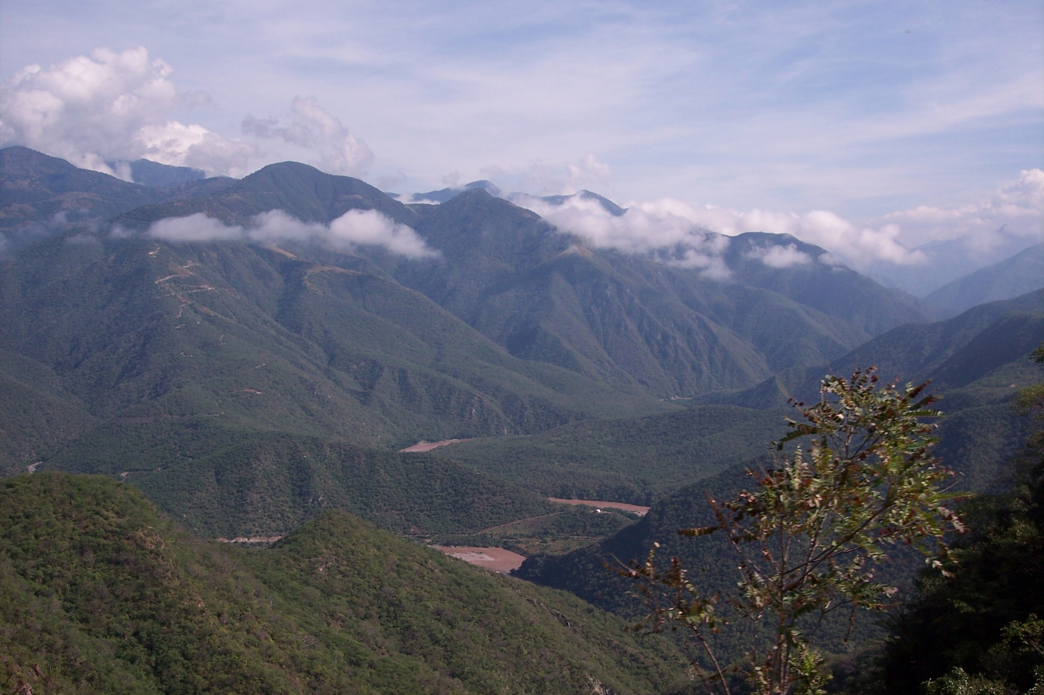
Sierra Madre Occidental
© Brain Wrinkles

Slide 10
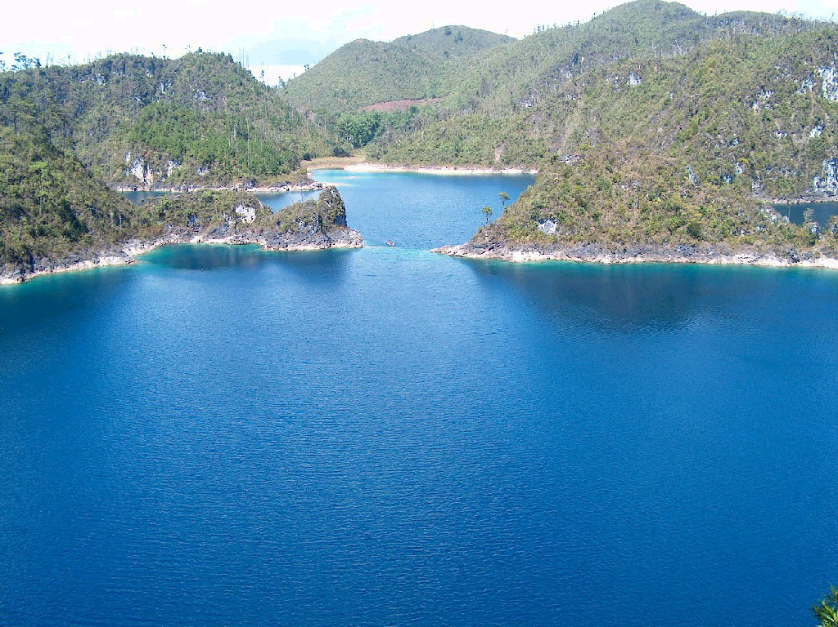
Chiapas (Mexican state)
© Brain Wrinkles

Slide 11
Natural Resources
Oil is one of the top exports:
Exports 1.7 million barrels/day.
Money from oil sales provides 1/3 of government’s budget.
Mexico is one of the world’s top producers of silver.
Other exports include fruits, vegetables, coffee, & cotton.
Tourism is also a major industry.
© Brain Wrinkles

Slide 12
Where People Live
Most people live in central Mexico:
Arable farmland with enough rain to grow crops
Many manufacturing centers are located here (provide jobs to 75% of the country’s population)
Urban: 77%
Rural: 23%
© Brain Wrinkles

Slide 13
Mexico City
© Brain Wrinkles

Slide 14
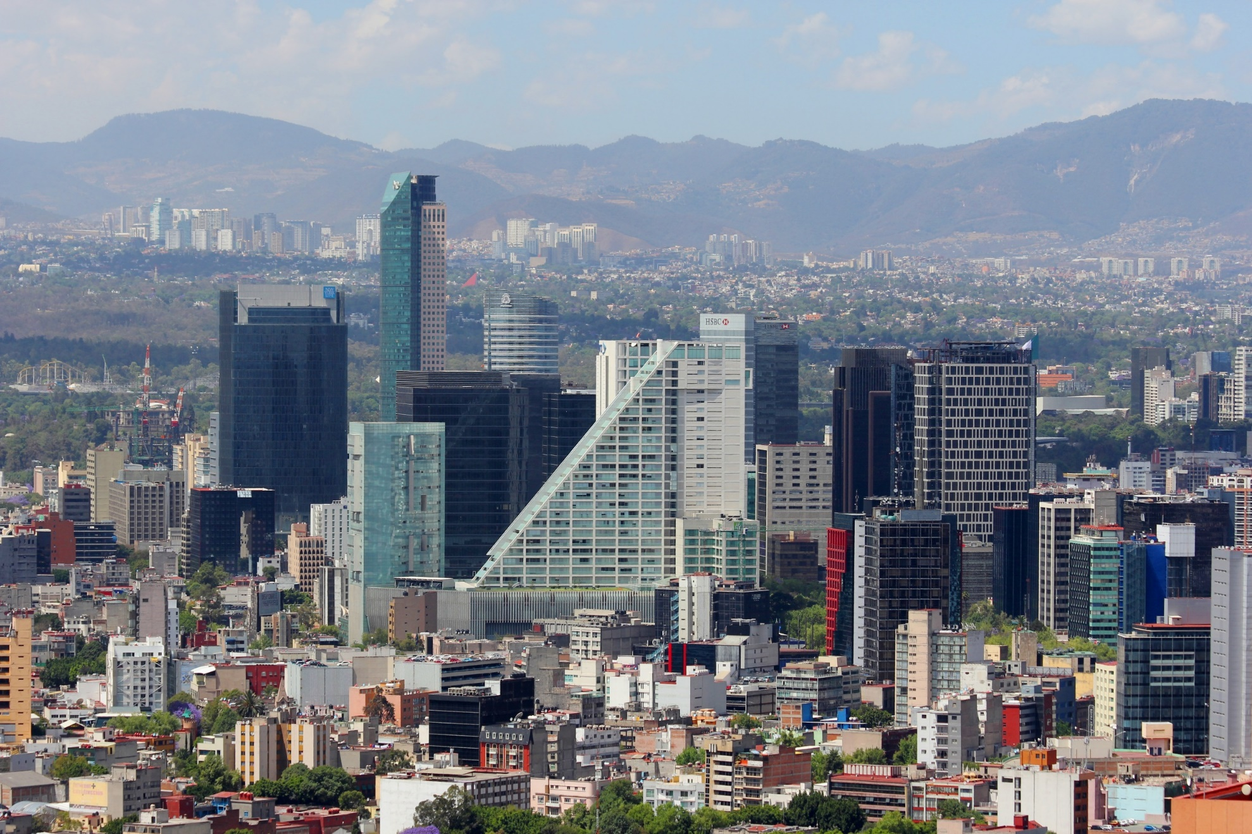
Mexico City
© Brain Wrinkles

Slide 15
How They Trade
Mexico has a mix of new and old industries.
Recently expanded railroads, airports, and electric generating plants
7 major seaports
Exports: oil, manufactured goods, silver, fruits, vegetables, coffee, & cotton
Tourism
© Brain Wrinkles

Slide 16
Venezuela
© Brain Wrinkles

Slide 17
Location
Venezuela is in the northeast part of South America, just north of equator.
It has coasts on Caribbean Sea and Atlantic Ocean.
This gives it easy access to trade with other countries.
The nearby Panama Canal provides a shortcut to the Pacific to trade with Asian countries.
There are mountains in the north and south, so only about 3% of the land is arable.
© Brain Wrinkles

Slide 18
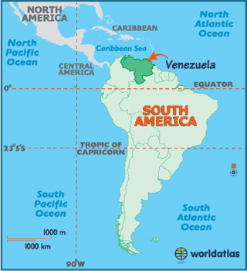
© Brain Wrinkles

Slide 19
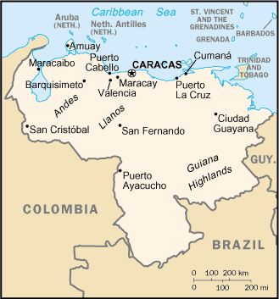
© Brain Wrinkles

Slide 20
Climate
Venezuela has a hot, tropical climate.
It’s cooler in the mountains.
Rain varies by region (16 inches on the coast; over 100 inches in the mountains).
© Brain Wrinkles

Slide 21
© Brain Wrinkles

Slide 22
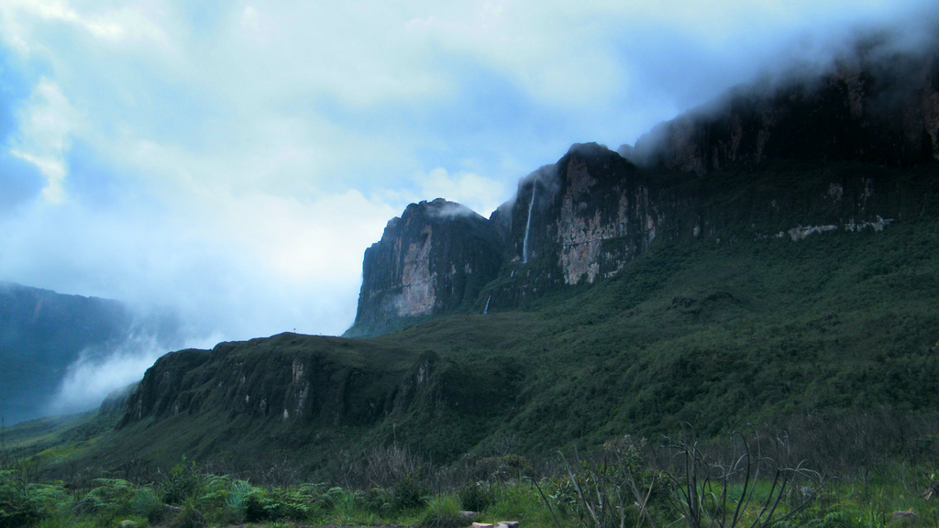
© Brain Wrinkles

Slide 23
Natural Resources
Venezuela is the sixth-largest oil exporter in the world.
It produces 2.8 million barrels/day.
90% of the money the government makes on trade comes from oil exports.
Farming provides jobs for 10% of the population.
© Brain Wrinkles

Slide 24
© Brain Wrinkles

Slide 25
Where People Live
Urban: 88%
Rural: 12%
Caracas is the largest city.
Most people live in the northern highlands, along the coast.
© Brain Wrinkles

Slide 26
Caracas
© Brain Wrinkles

Slide 27
Caracas
© Brain Wrinkles

Slide 28
How They Trade
90% of money made on exports comes from oil.
4 major seaports
Other exports: bauxite and aluminum, steel, chemicals, agricultural products, basic manufactures
Tourism
© Brain Wrinkles

Slide 29
Cuba
© Brain Wrinkles

Slide 30
Location
Cuba is an island 90 miles south of Florida, in the Caribbean Sea.
It’s only 700 miles long.
It’ the largest island in the West Indies.
It’s location on ocean trading routes has been an important influence on its history and economy.
© Brain Wrinkles

Slide 31
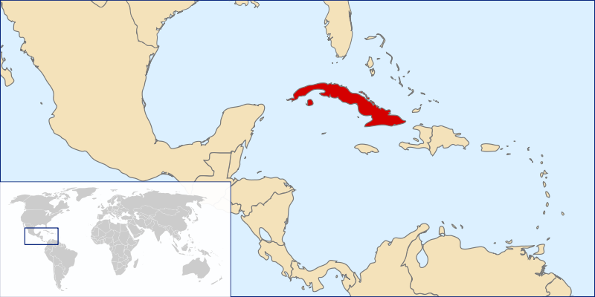
© Brain Wrinkles

Slide 32
Climate
The climate is tropical but moderated by trade winds.
(It’s warm-to-hot all year long, but the winds provide relief from the heat.)
There’s a rainy season from May to October and a dry season from November to April.
Cuba is a target for hurricanes.
Hurricane season runs from June to November.
© Brain Wrinkles

Slide 33
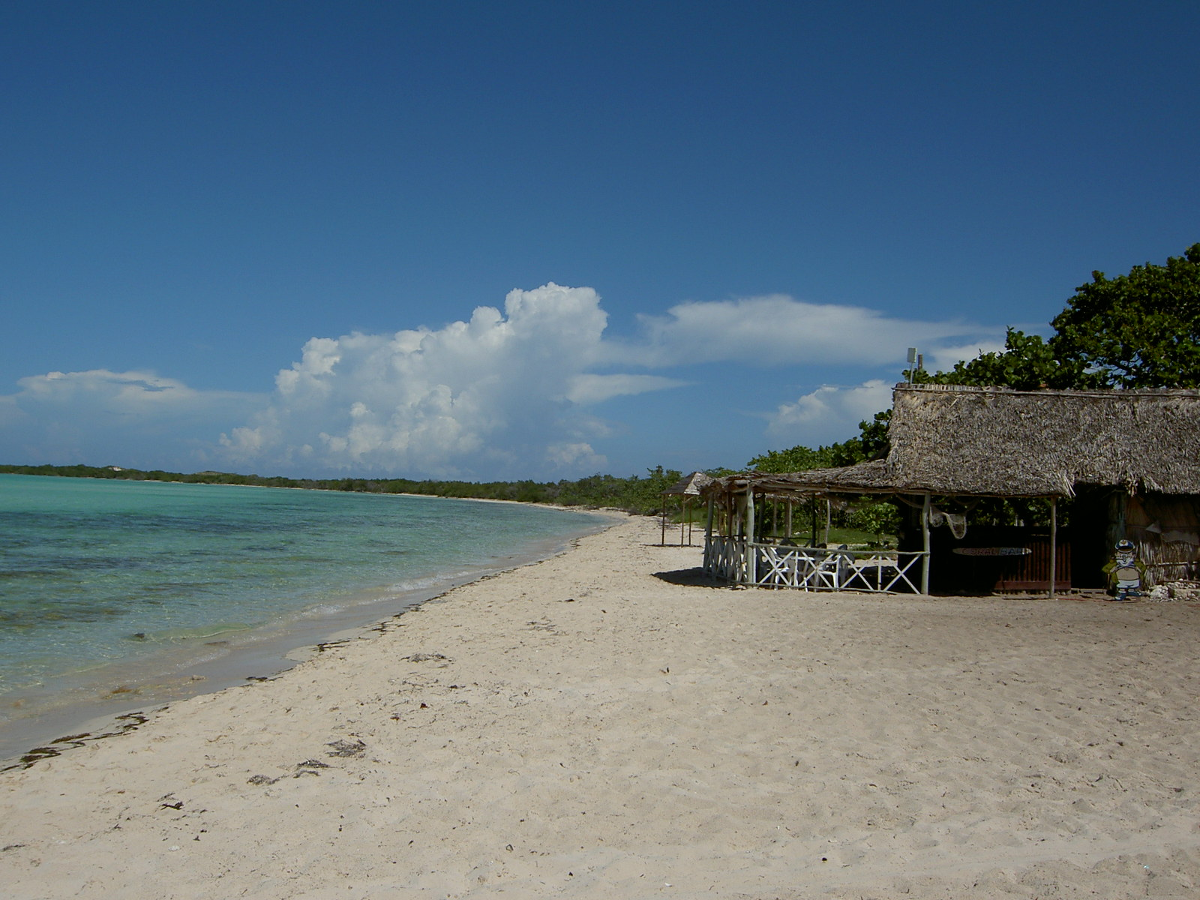
© Brain Wrinkles

Slide 34
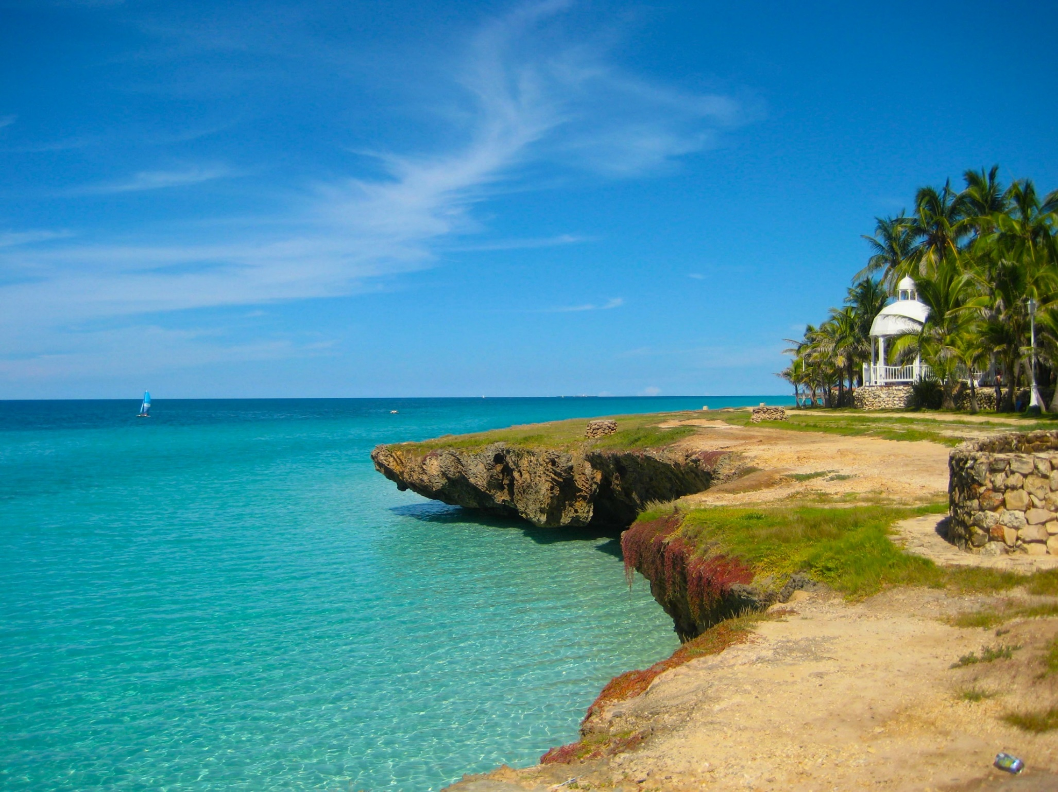
© Brain Wrinkles

Slide 35
Natural Resources
28% of Cuba’s land is arable.
It’s most important export is sugar cane.
Other exports include: coffee, fish, fruits, & tobacco.
Tourism is a fast-growing industry.
© Brain Wrinkles

Slide 36
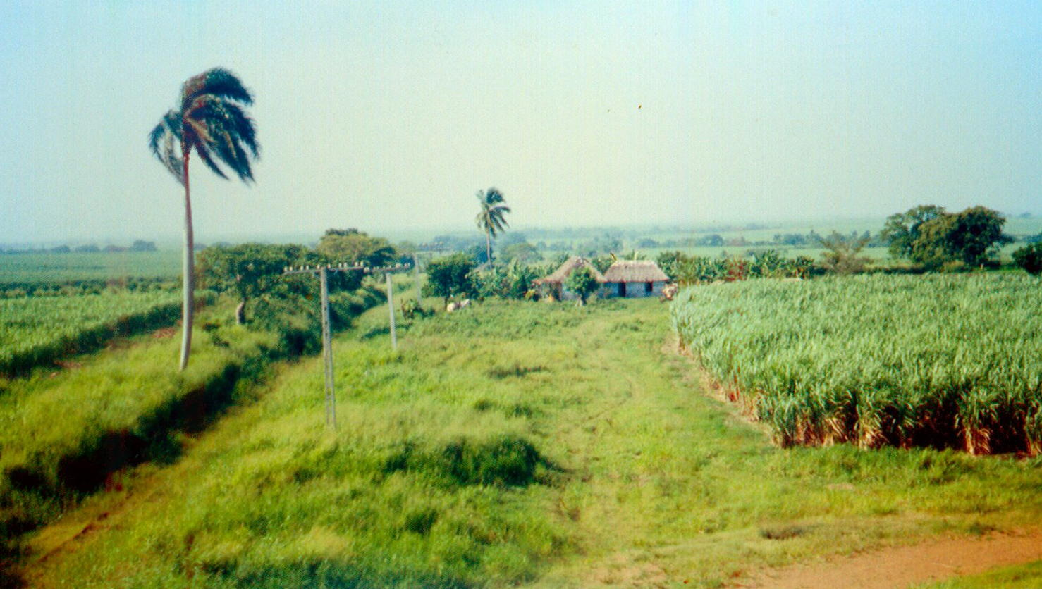
Sugar Cane Farm
© Brain Wrinkles

Slide 37
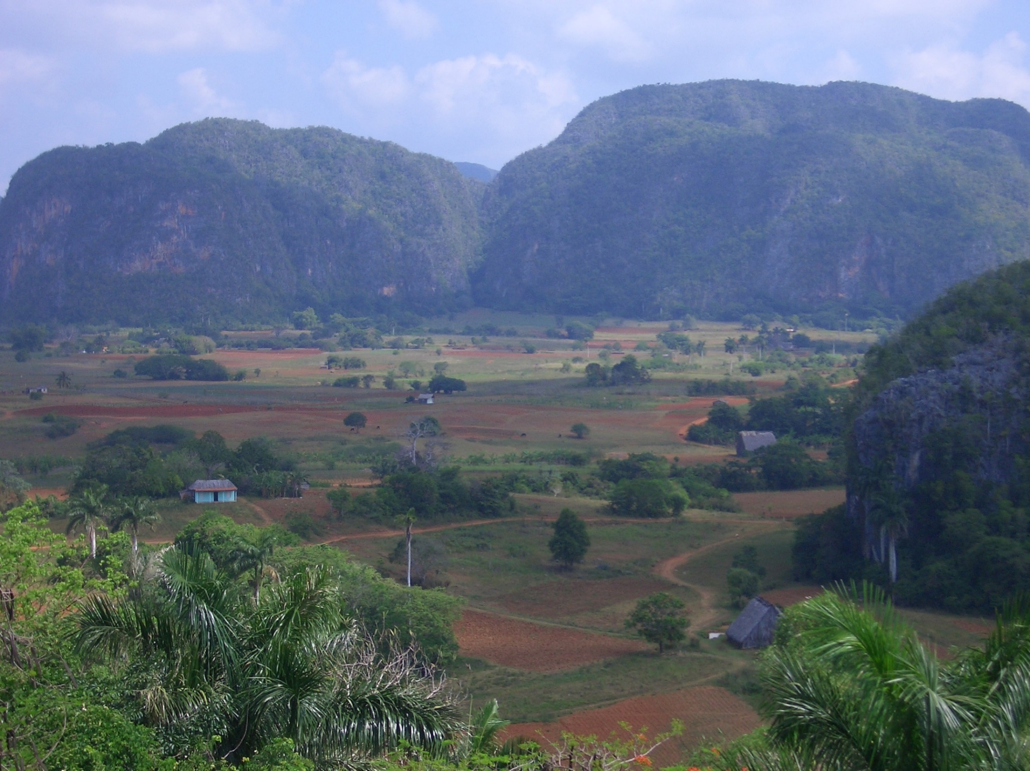
© Brain Wrinkles

Slide 38
Where People Live
Urban: 76%
Rural: 24%
Havana is the largest city.
20% of Cubans live in Havana.
© Brain Wrinkles

Slide 39
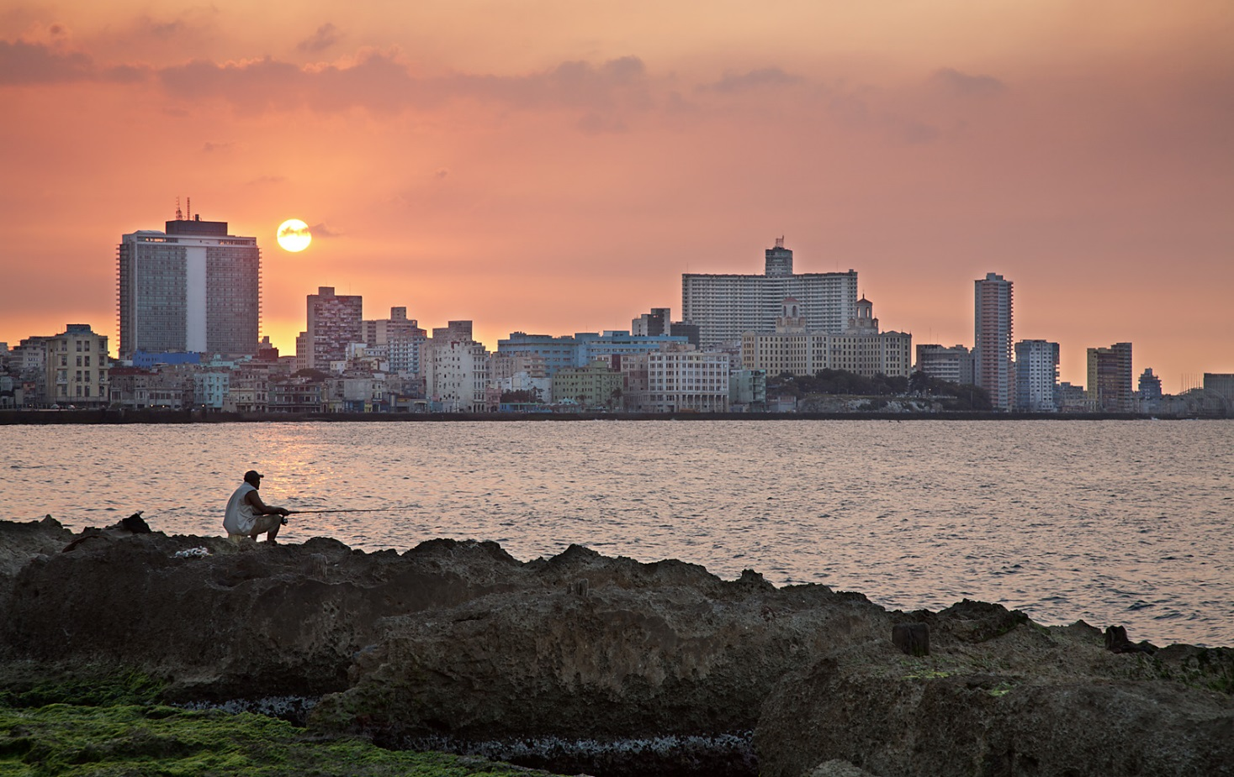
Havana
© Brain Wrinkles

Slide 40
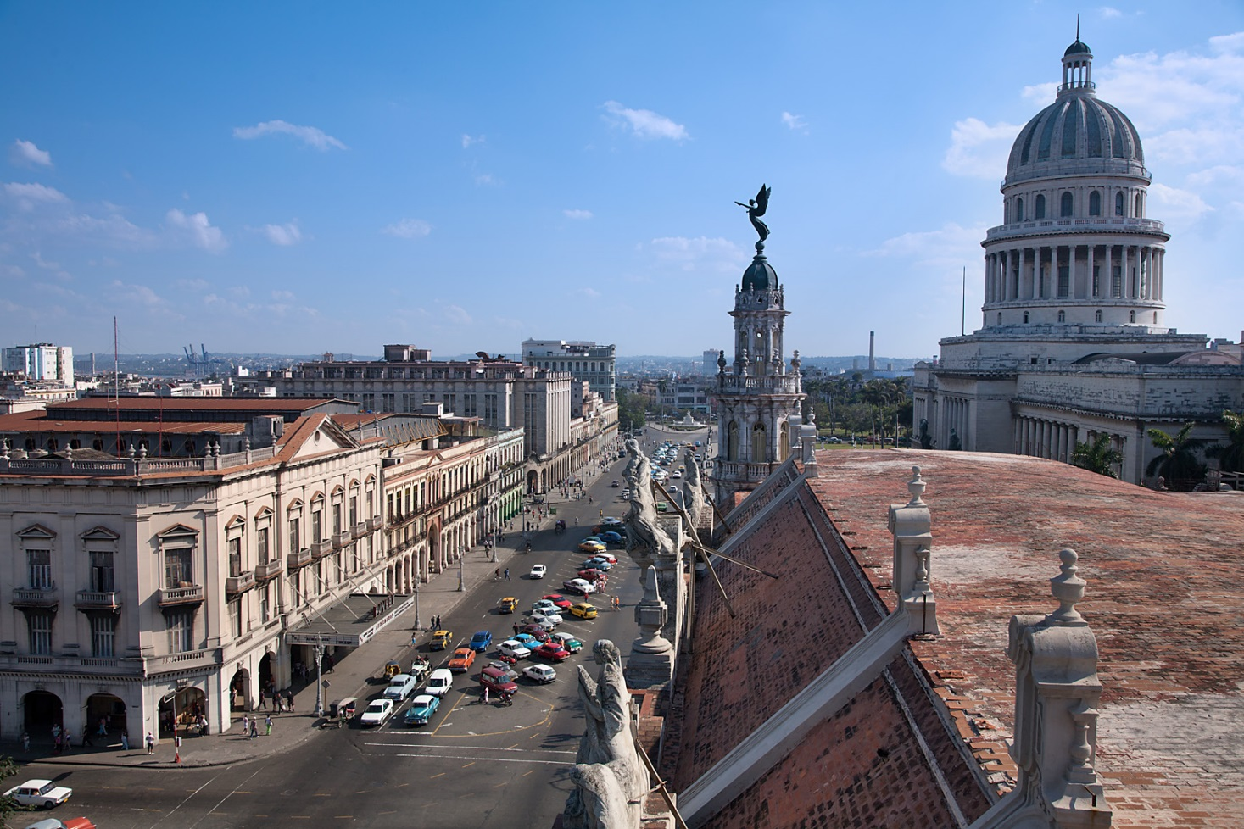
Havana
© Brain Wrinkles

Slide 41
How They Trade
3 major seaports
Exports: sugar, nickel, tobacco, fish, medical products, citrus, coffee
Tourism
Venezuela is Cuba’s largest trading partner; it sells oil to Cuba at a reduced price.
© Brain Wrinkles

Slide 42
How They Trade
The Communist government of the Soviet Union helped support Cuba for many years.
When it collapsed in 1991, Cuba faced difficult times.
Trade from other countries does not bring in enough money to meet needs of Cuba’s people.
Government sometimes orders businesses & factories to close.
It also orders blackouts—times when all electricity is cut off in order to save electricity.
© Brain Wrinkles

Slide 43
Brazil
© Brain Wrinkles

Slide 44
Location
Brazil is on the eastern side of South America, along the coast of the Atlantic Ocean.
It shares a border with nearly every country in South America!
Amazon River and other large rivers stretch across Brazil.
© Brain Wrinkles

Slide 45
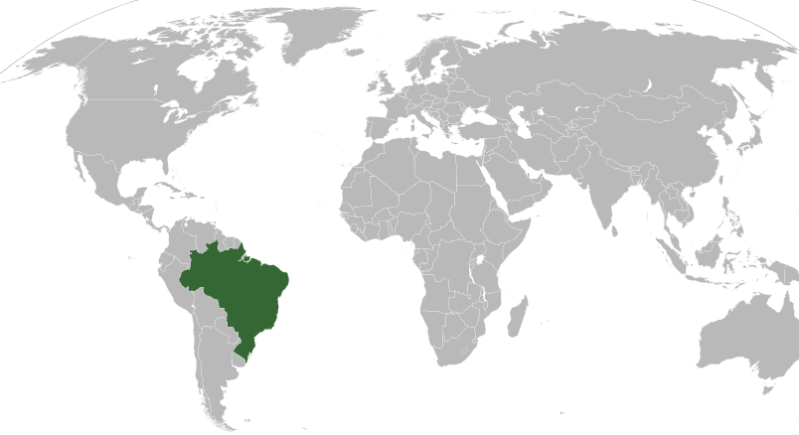
© Brain Wrinkles

Slide 46
Climate
Brazil’s location on the equator gives it the climate needed to support one of the world’s largest rain forests.
Its climate is mostly hot and tropical.
In the south, the climate is temperate (mild).
© Brain Wrinkles

Slide 47
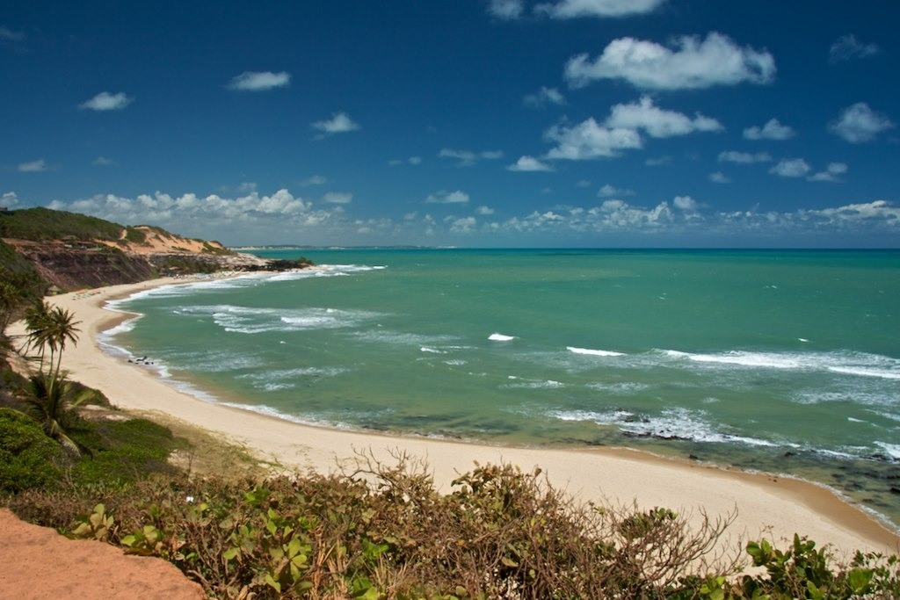
© Brain Wrinkles

Slide 48
Natural Resources
Only 7% of land is arable, but Brazil makes the most of this resource.
Farmers grow 1/3rd of the world’s coffee, and lead the world in production of oranges, papayas, sugar cane, and soybeans.
Only the US exports more farm products than Brazil.
© Brain Wrinkles

Slide 49
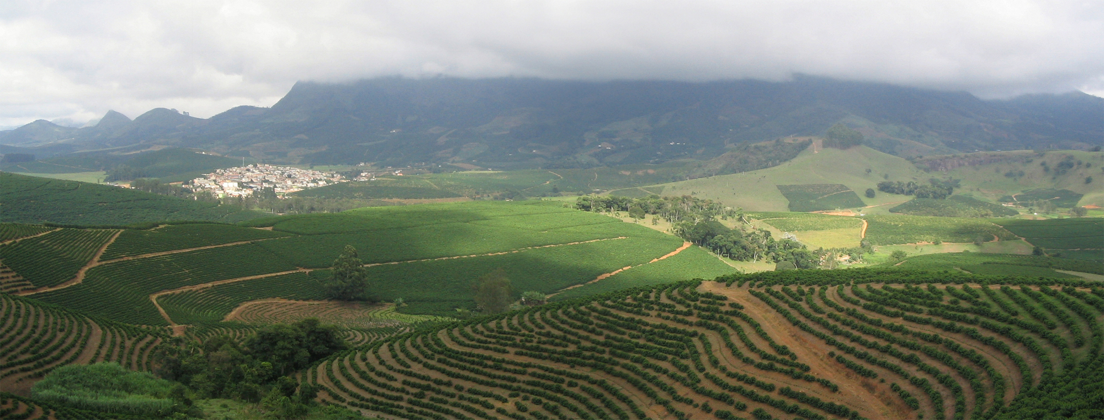
Coffee Plantation
© Brain Wrinkles

Slide 50
Where People Live
Urban: 84%
Rural: 16%
It’s the most populated country in Latin America.
It’s the largest Portuguese-speaking country in the world.
Most Brazilians live along the coasts; 80% live within 200 miles of the ocean.
© Brain Wrinkles

Slide 51
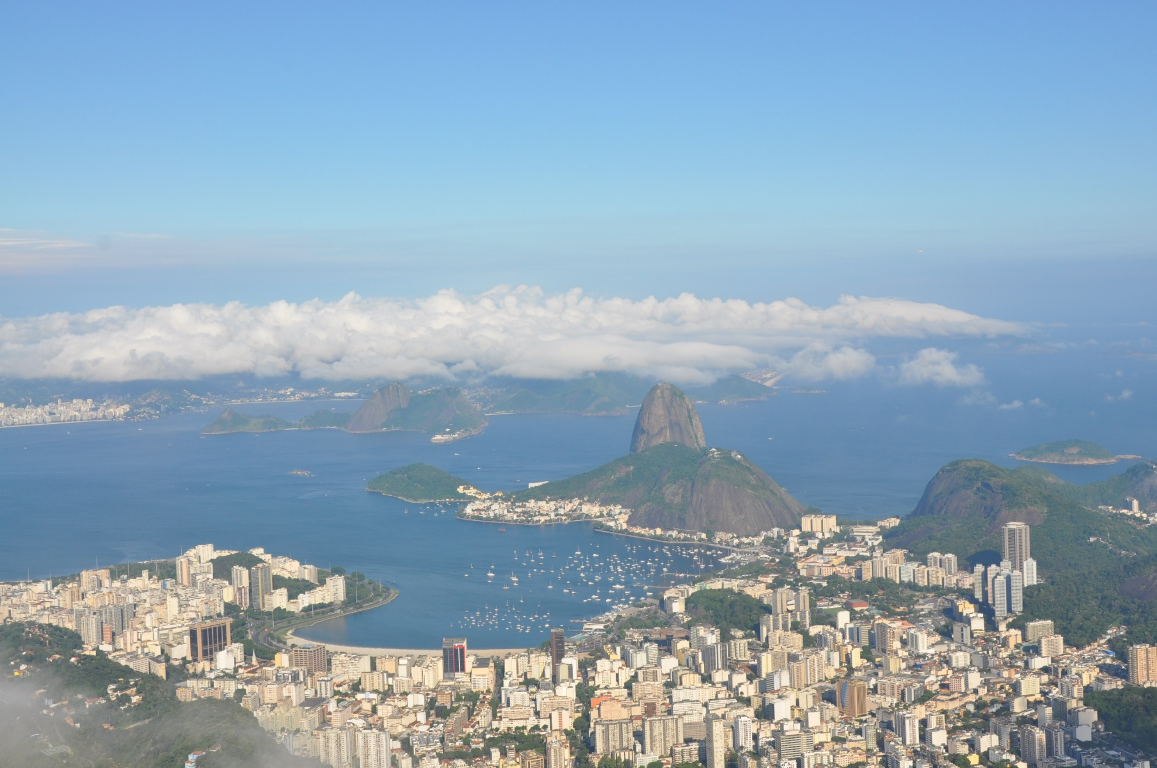
© Brain Wrinkles

Slide 52
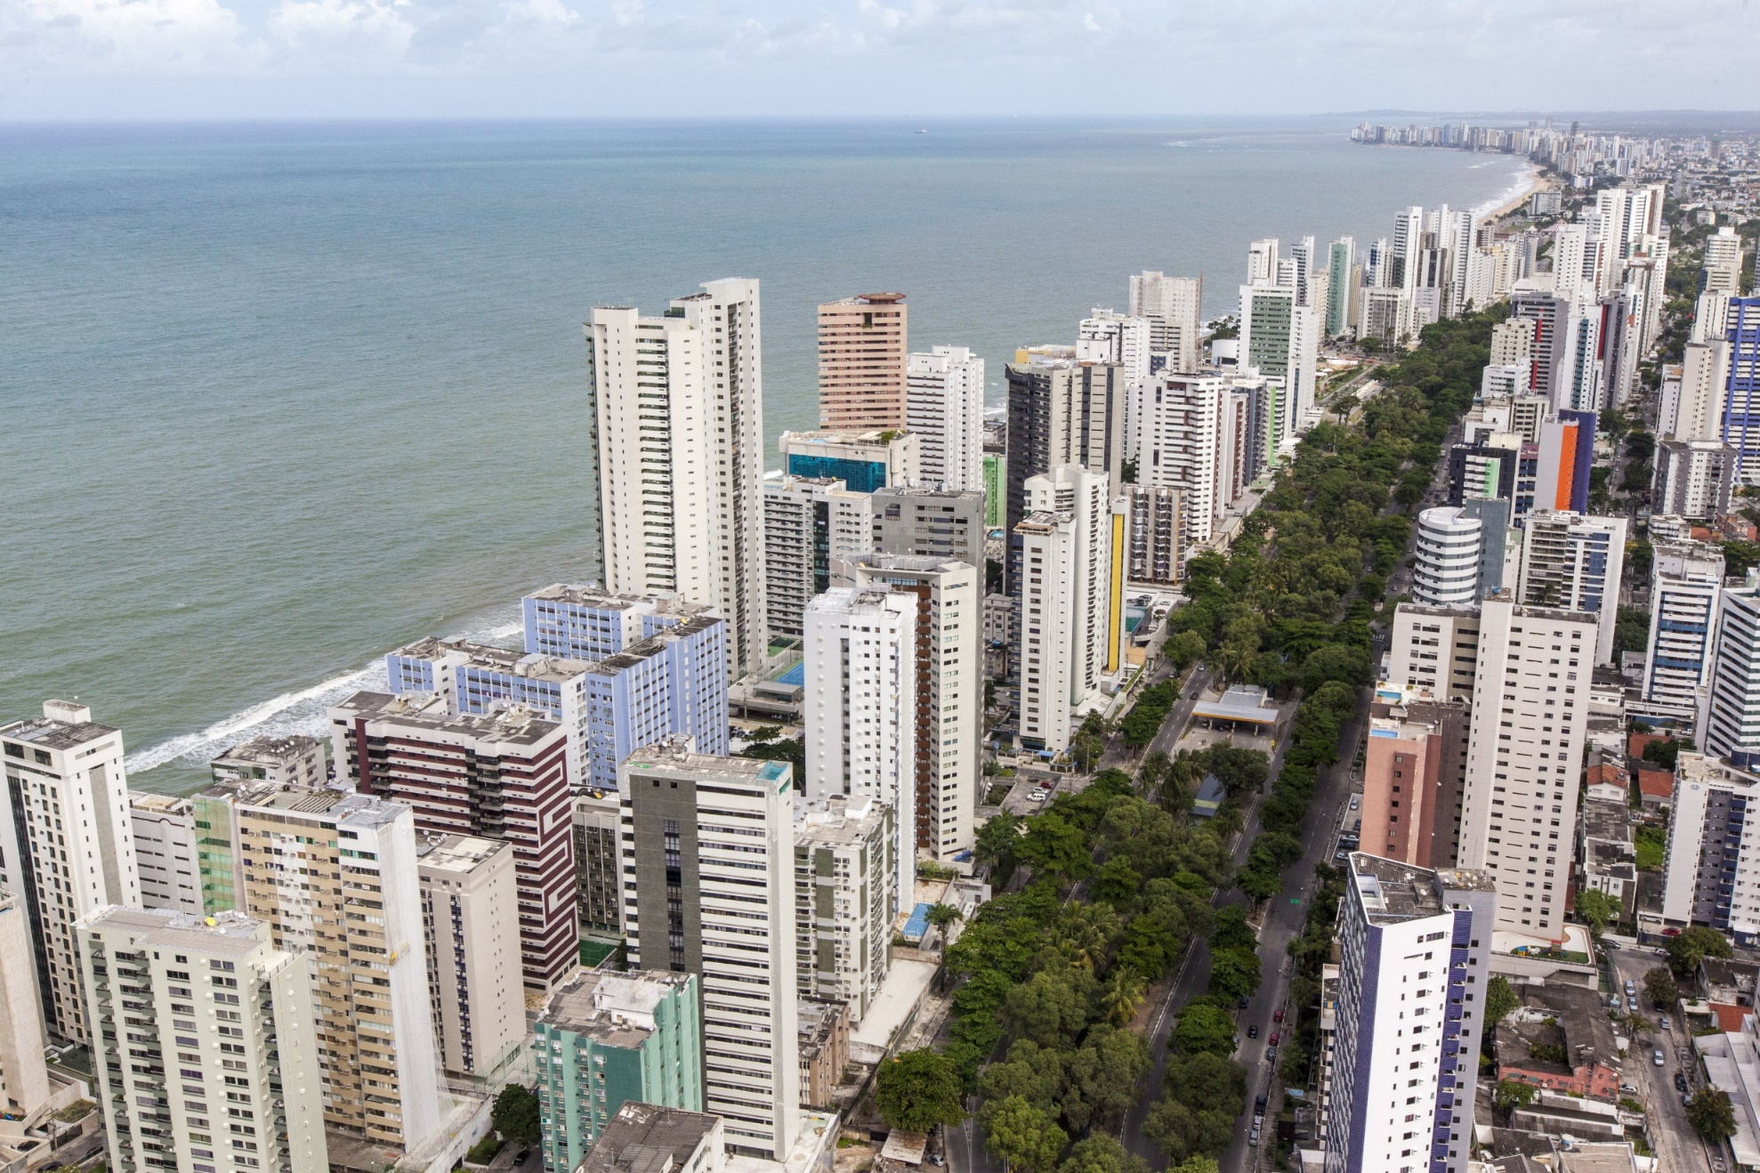
© Brain Wrinkles

Slide 53
How They Trade
Urban: 84%
Rural: 16%
It’s the most populated country in Latin America.
It’s the largest Portuguese-speaking country in the world.
Most Brazilians live along the coasts; 80% live within 200 miles of the ocean.
© Brain Wrinkles

