Slide 1
Unit One
Pre and Post Assessment

Slide 2
SS8G1a. 1. Which statement accurately explains Georgia's location?
A)It is along the Atlantic Coast in the Eastern Hemisphere.
B)It is along the Pacific Coast in the Western Hemisphere.
C)It is in the northwestern region of South America.
D)It is in the southeastern region of North America.

Slide 3
SS8G1b. 2. Which terms best describes the Piedmont region of Georgia today?
A)broad treeless plains, richest soil in Georgia
B)heavily forested, highest elevation in Georgia
C)gently sloping land, lowest elevation in Georgia
D)rolling farmland, most heavily populated region of Georgia

Slide 4
SS8G1c 3. What is the natural boundary that separates the Coastal Plain and Piedmont regions?
A)Fall Line
B)Savannah River
C)Atlantic coastline
D)Appalachian Mountains

Slide 5
SS8G1c 4. What geographic region of Georgia is located between the Coastal Plain and the mountains?
A)Fall Line
B)Piedmont
C)Georgia Plateau
D)Ridge and Valley

Slide 6
SS8G1b 5. Which of the following BEST describes Georgia's coastal plain region?
A)mountainous land bordering Florida
B)rolling land in the middle of the state
C)level land bordering the Atlantic Ocean
D)steep highland in the northern part of the state

Slide 7
SS8G1b. 6. The textile industry has been one of Georgia's primary industries. The textile industry developed mainly along the
A)Coastal Plain.
B)Altamaha River.
C)Fall line.
D)Chattahoochee River.

Slide 8
SS8G1c. 7. Which physical feature is located in the coastal plains region of Georgia?
A)Brasstown Bald
B)Okefenokee Swamp
C)Chattahoochee River
D)Lake Sidney Lanier

Slide 9
SS8G1a. 8 In which two hemispheres is the state of Georgia located?
A)northern and eastern
B)northern and western
C)southern and eastern
D)southern and western

Slide 10
SS8G1d 9. Why did early settlers make their homes along the fall line?
A)The coastline was a fishing and shrimping center.
B)Waterfalls in the area provided a source of power.
C)The Blue Ridge Mountains received an abundance of rainfall.
D)The 32° line of latitude was Georgia's southern border at that time.

Slide 11
SS8G1c 10. Which statement is the most accurate description of the Okefenokee Swamp?
A)It is an estuary where freshwater and salt water mix.
B)It is a major source of drinking water for southern Georgia.
C)It is Georgia's largest freshwater wetland.
D)It is located along the Atlantic Intracoastal Waterway.

Slide 12
SS8G1a. The state of Georgia is found in BOTH the
A) Northern and Western hemispheres.
B) Northern and Eastern hemispheres.
C) Southern and Western hemispheres.
D) Southern and Eastern hemispheres.

Slide 13
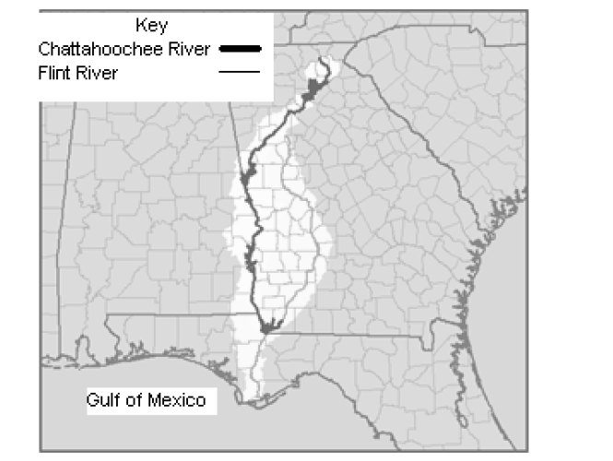
SS8G1c. 12. How MIGHT the location of the Chattahoochee River have contributed to the development of trade in Georgia?
A) The natural beauty of the river continues to attract development along the banks of the river.
B) It allowed Atlanta to become a successful trade center with unobstructed river travel to the Atlantic Ocean.
C) It allowed Columbus to become a thriving cotton-marketing center with unobstructed river travel to the Gulf of Mexico.
D)It did not contribute to the development of trade in Georgia because of the waterfalls associated with the fall line of
Georgia.

Slide 14
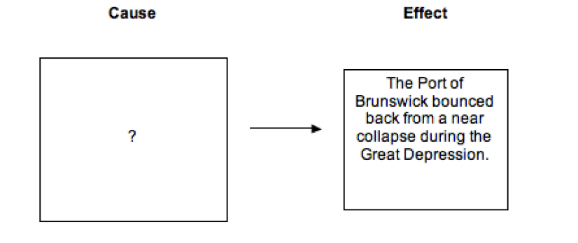
SS8G1d 13. Which BEST completes the diagram?
A) the end of the slave trade in Georgia
B) the creation of the Georgia Port Authority
C) the expansion of the interstate highway system
D) the construction of cargo ships in the port

Slide 15
SS8G1d. 14. Which of these FIRST connected the port of Savannah to domestic markets in the west?
A) airports
B) railroads
C) public roads
D) interstate highways

Slide 16
SS8H1a. 15. Which development resulted in increased population and permanent settlements among Georgia's prehistoric Native Americans?
A)Improved weapons meant that more animals could be killed efficiently.
B)The Native Americans began to trade throughout eastern North America.
C)Improvements in agriculture meant food could be grown and stored.
D)The tribes established more complicated social structures and ceremonies.

Slide 17
SS8H1c. 16. What was a misunderstanding that many times led to warfare between Europeans and
Native Americans?
A)disagreement about a division of labor between men and women
B)differences about common ownership of land in North America
C)wanting a common language and culture throughout North America
D)Native American insistence that white Europeans adopt Native American customs and beliefs

Slide 18
SS8H1c. 17. Under the trustees, who was allowed to settle in Georgia in colonial times?
A) those with prison sentences
B) those selected by the trustees
C) those who could afford passage
D) those who were married with families

Slide 19
SS8H2a. 18. When the Georgia colony was established, which religious group was
not allowed to settle in it?
A)Jews
B)Puritans
C)Catholics
D)Protestants

Slide 20
SS8H1a. 19. Cultural differences often lead to conflict between cultural groups. There were many differences between the culture of the first white settlers in Georgia and the Native American population. Which statement best describes a major difference between the early Georgia settlers and the Native Americans?
A)Georgia's Native Americans were nomadic; whites people settled in towns and other permanent settlements.
B)Georgia's Native Americans held no spiritual beliefs; white settlers believed in an all-powerful god.
C)Georgia's Native Americans' warfare methods were uncivilized; white settlers used more civilized methods of warfare.
D)Georgia's Native Americans recognized no one person's right to own property; white people felt that the ownership of personal property was very important.

Slide 21
SS8H1c. 20. How did Hernando de Soto's travels throughout Georgia and other southern states NEGATIVELY IMPACT the Native Americans living there?
A)The Spanish soldiers brought death and disease.
B)The Native Americans adopted many European customs.
C)The Native Americans joined de Soto's quest for gold.
D)The soldiers lived among the Native Americans in peace.

Slide 22
SS8H2b. 21. Tomochichi played a significant role in the early settlement of Georgia because
A)he was the chief of the Yamacraw Indians.
B)he created his own tribe of Creek and Yamasee Indians.
C)he was the mediator between the Yamacraw and the English settlers.
D)he served to protect the colony of Georgia from the Spanish at St. Augustine.

Slide 23
SS8H1a. 22. The Woodland tribe, who lived in Georgia from about 1000 bce to 1000 ce., built many earthen mounds, such as Rock Eagle Mound in northern Georgia. Anthropologists believe these mounds were used mainly
for
A)protection from enemies.
B)religious and ceremonial purposes.
C)housing a tribe's families.
D)trading and commerce centers.

Slide 24
SS8H1b. 23. Why did early Georgia colonists work to maintain good relations with Native Americans?
A)The colonists believed they might need Native Americans to help defend
themselves against Spain.
B)The colonists wanted Native Americans to join them in a rebellion
against Great Britain.
C)The colonists needed to convince Native Americans to give up their land
without a treaty.
D)The colonists wanted to make up for past hostilities between themselves
and Native Americans.

Slide 25
SS8H2a. 24. Which statement best describes the principles governing the colony of Georgia in 1732?
A)People of all religions were welcome to settle in Georgia.
B)The government was one of America's early democracies.
C)There were strict rules about land-ownership and work.
D)Only people who could afford to own large plantations were encouraged to settle.

Slide 26
SS8H2a. 25.
A)a Board of Trustees
B)James Oglethorpe.
C)King George II.
D)Parliament..

Slide 27
SS8H2a. 26. Which statement best explains why England established the Georgia colony?
A)England wanted a port available for ships sailing to China and the East
Indies.
B)England wanted to create a trading partnership with the Native
Americans.
C)England wanted to provide a safe haven for Catholics who were being
persecuted.
D)England wanted a buffer state to prevent Spanish and Native American
invasions of South Carolina.

Slide 28
SS8H1b. 27. Which explorer is most associated with the exploration of Georgia?
A)Ponce de León
B)Amerigo Vespucci
C)Hernando de Soto
D)Christopher Columbus

Slide 29
SS8H2c. 28. In the early years of the colony, what was one reason the colonists were dissatisfied with the policies of the trustees who governed colonial Georgia?
A)The colonists could not own slaves.
B)The colonists were not allowed to practice their religion. C)The colonists were not allowed to read books.
D)The colonists could not pay the high taxes required of them.

Slide 30
SS8H2b. 29. James Oglethorpe’s hiring of Mary Musgrove had a positive impact on English and Native relations because
A) she assembled a group of Creek Native Americans who defended her.
B) the Native Americans did not communicate with any other Europeans.
C) she helped to make fair trades and negotiations between the groups.
D) the Native Americans saw her hiring as a sign of Oglethorpe’s good will.

Slide 31
SS8H2a. 30. The government of England MOST LIKELY thought the Georgia colony would make a good military defense because
A) Native Americans in Georgia could help them.
B) it was full of many skilled and brave soldiers.
C) its geography made it very easy to fight there.
D) it could help to protect other English colonies.

Slide 32
SS8H2c. 31. James Oglethorpe wanted the Highland Scots to move to Georgia
A) because they were qualified in the lumber industry.
B) so that the colony would have many types of people.
C) because they were experienced and skilled soldiers.
D) so that they would bring Protestantism to the colony.

Slide 33
SS8H2c. 32. The Salzburgers are MOST associated with what time period in Georgia history?
A) Antebellum
B) Colonial
C) Reconstruction
D) Revolutionary

Slide 34
SS8H2c. 33. Who was the second Royal Governor of Georgia and is often credited with being the "second founder" of Georgia?
A) Henry Ellis
B) James Wright
C) John Reynolds
D) James Oglethorpe

Slide 35
SS8H2d. 34. What industry dramatically increased as a result of the Georgia colony lifting the ban on slavery?
A) rice industry
B) indigo industry
C) textile industry
D) tobacco industry

Slide 36
SS8H2d. 35. The first royal governor of Georgia, John Reynolds, was viewed as a poor leader. Which characteristic put Reynolds’ citizens in the MOST danger?
Reynolds’ lack of skill in Indian diplomacy
Reynolds’ isolation of other political leaders
C) Reynolds’ desire for a more lucrative position
D) Reynolds’ appointment of friends to the cabinet

Slide 37
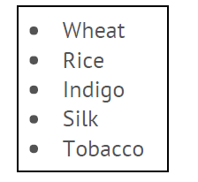
SS8H2e. 36. In what period of Georgia history would these products have been MOST likely to have been profitable?
A) The Colonial Period
B) The Great Depression
C) The Reconstruction Era
D) The Post-World War II Era

Slide 38
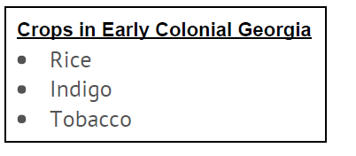
SS8H2e. 37. What conclusions can you draw from this list of crops?
A) Georgia agriculture was not very successful.
B) Georgia agriculture required a large amount of labor.
C) Georgians only grew crops that were able to be eaten.
D) Georgians did not grow any crops meant for human consumption.

Slide 39
SS8H2e. 38. If you traveled back to the Colonial Period in Georgia, which crop would you have been LEAST likely to see being grown?
A) cotton
B) indigo
C) rice
D) tobacco

Slide 40
SS8H3d. 39. The French-Indian/Seven Years War is often viewed by historians as being a factor in causing the American Revolution. Which
of these BEST explains why this might be the case?
A) The Indians believed the colonists would return seized lands to them.
B) The British were able to defeat the French in North America, Asia, and at sea.
C) The high cost of the war meant Parliament had to create new taxes in the American colonies.
D) The French were never truly expelled and played a large role in stirring-up colonial discontent.

Slide 41
SS8H3c. 40. A Patriot in North America in the 1770s would have MOST LIKELY supported which of these?
A) boycotting British-made goods
B) supporting the "Coercive Acts"
C) remaining a part of Great Britain
D) becoming a member of the "red coats"

Slide 42
SS8H3c 41. A Loyalist in North America in the 1770s would have MOST LIKELY supported which of these?
A) revolution against the King
B) boycotting British-made goods
C) remaining a part of Great Britain
D) declaring independence from Great Britain

Slide 43
SS8H3a 42. Which of the following statements most accurately describes Georgia at the beginning of the Revolutionary War?
A)The royal governor was very unpopular.
B)Georgia relied heavily upon trade with England.
C)A strong tradition of self-government had developed.
D)Most Georgians strongly favored independence from England.

Slide 44
SS8H3c. 43. The leader of the rebel militia group that defeated 800 British troops at the Battle of Kettle Creek was
A)Lyman Hall.
B)Elijah Clark.
C)Austin Dabney.
D)John Treutlen.

Slide 45
SS8H3b. 44. What was the purpose of the Declaration of Independence?
A)to serve as a preamble to the Constitution
B)to demand that the colonists be given the same rights as British citizens
C)to dissolve the political connection between the colonies and Great Britain
D)to inform King George III that the colonies had ratified the Articles of Confederation

Slide 46
SS8H3d 45. At the Constitutional Convention in 1787, the Great Compromise was introduced in order to
A)end the debate over slavery.
B)separate Virginia and West Virginia.
C)maintain peace between England and America.
D)give equal representation to both large and small states.

